Slide 1
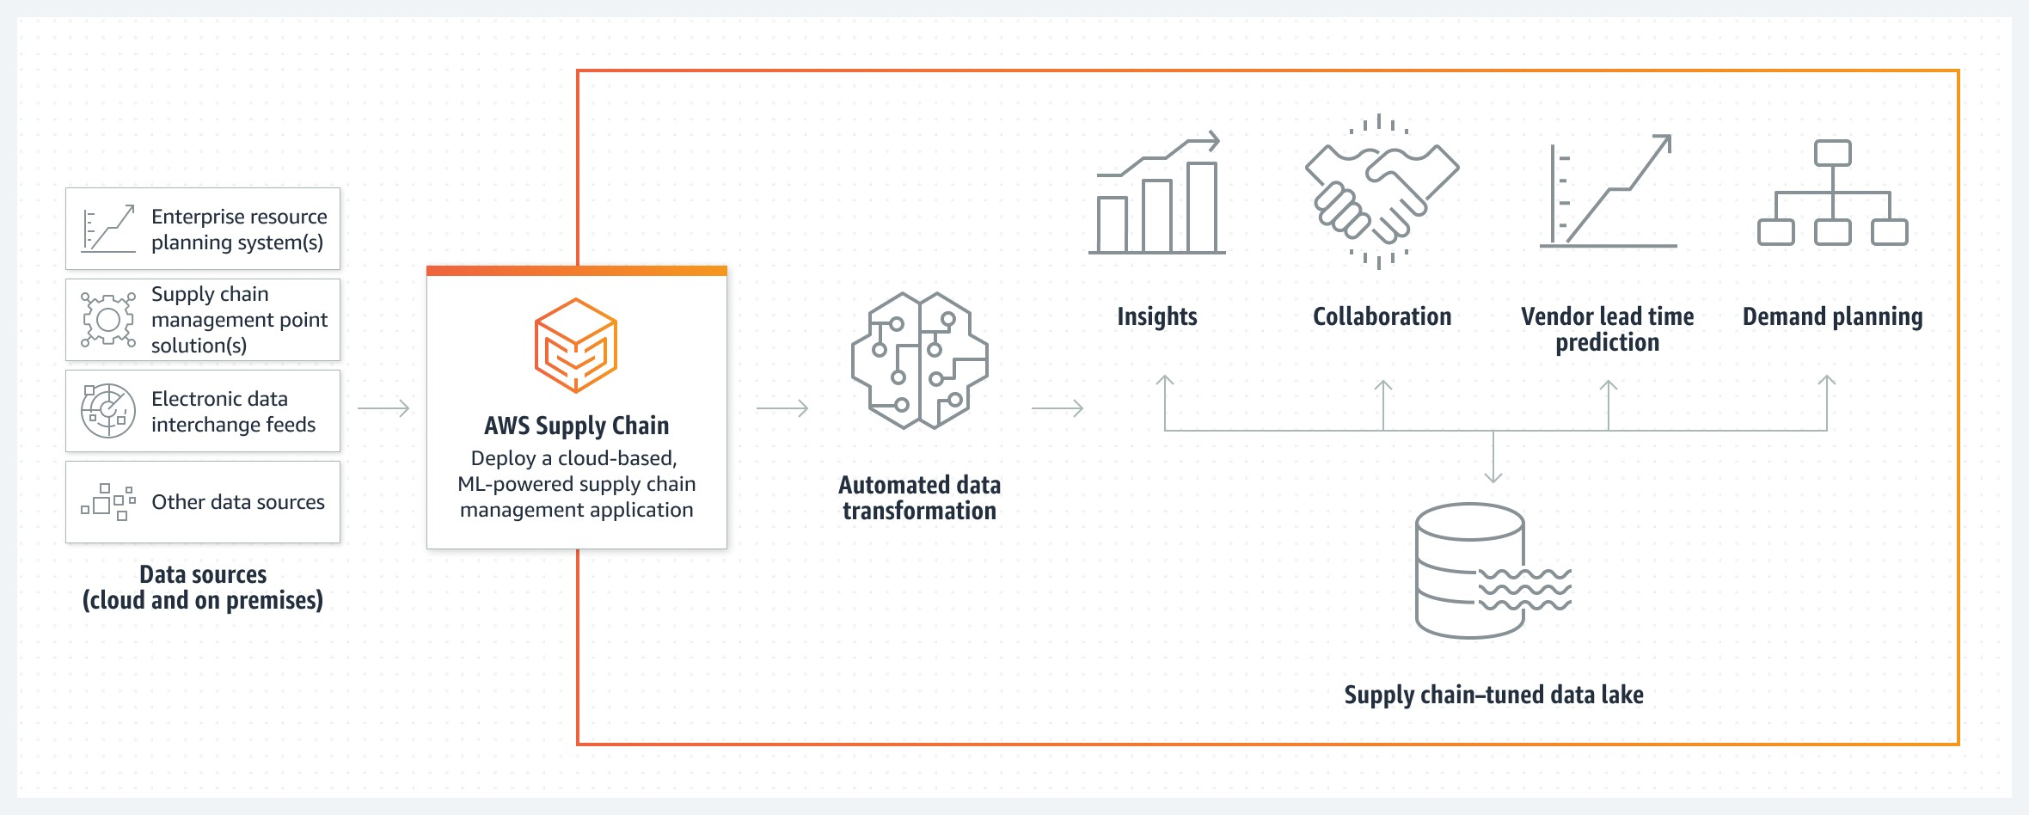
Supply Chain Management

Slide 2
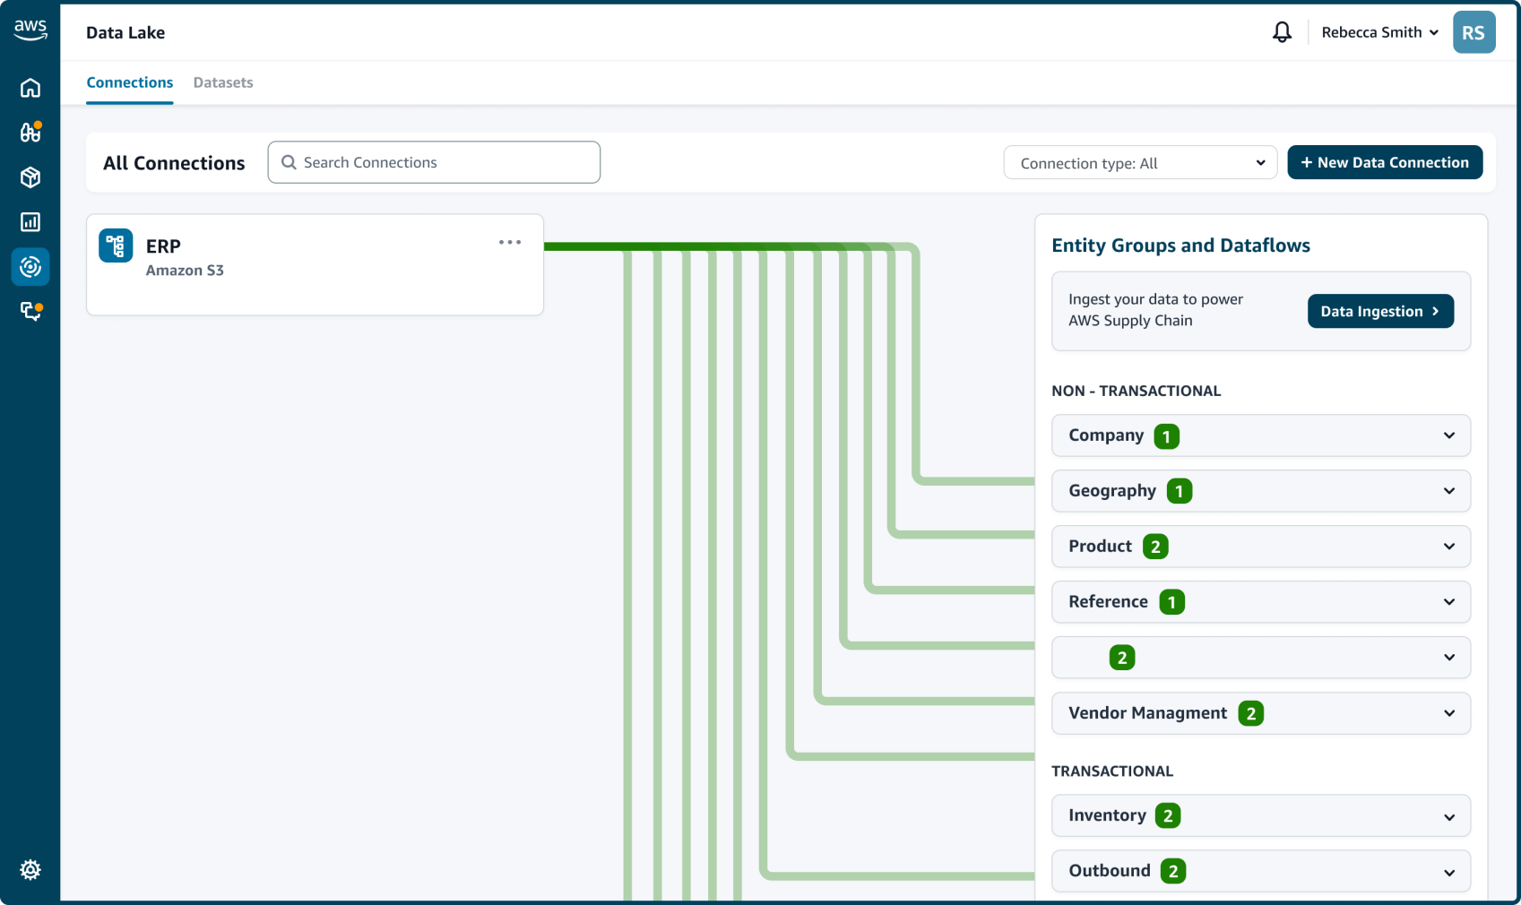
AWS Supply Chain Key Features
Supply chain Data Lake
  The data lake can ingest your data from various data sources, including your existing ERP systems.
  You can also load data from other systems to an Amazon Simple Storage Service (S3) bucket, where it will be automatically ingested into the AWS Supply Chain data lake.

Slide 3
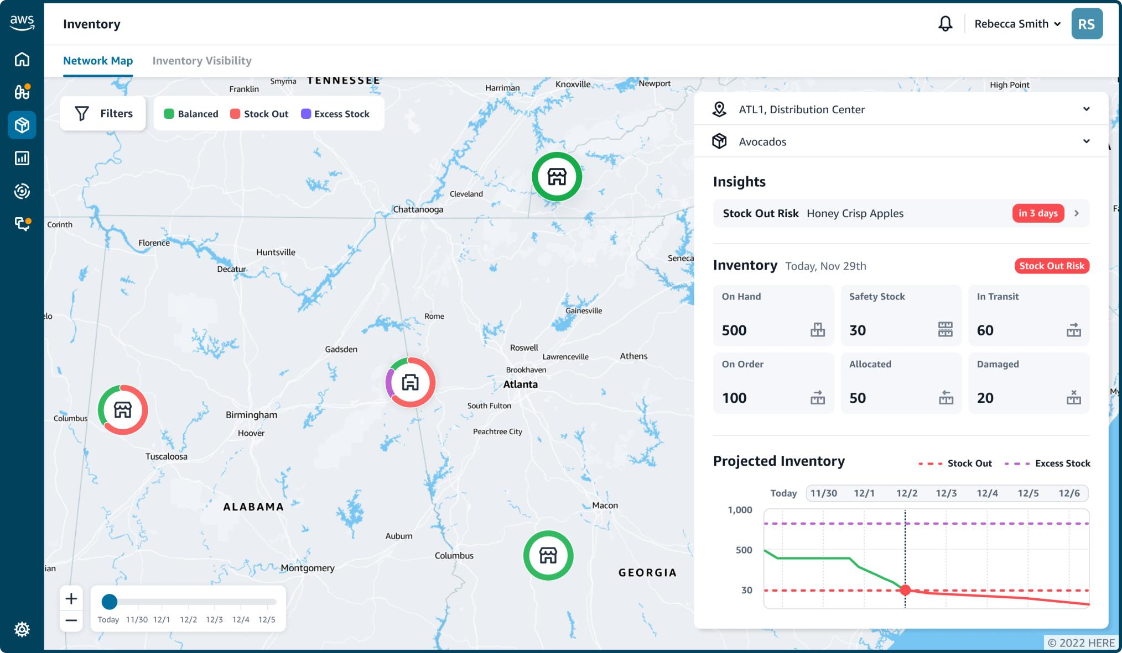
2. Real-time visual map:
AWS Supply Chain then highlights current inventory selection and quantity, as well as the health of inventory at each location (for example, inventory that is at risk for stock out).

Slide 4
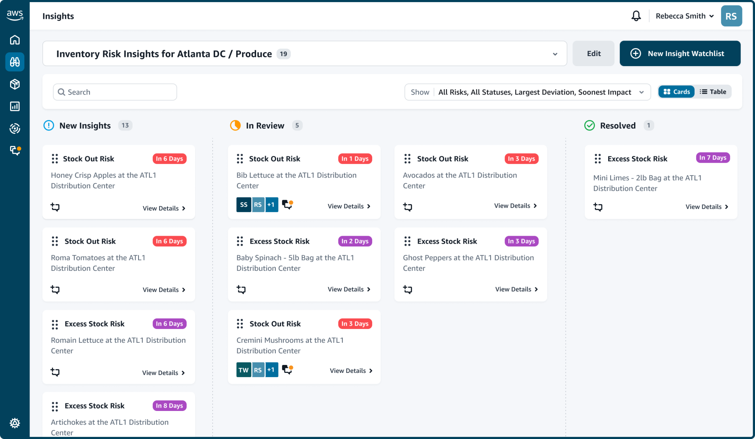
3. Insights
AWS Supply Chain automatically generates insights to potential supply chain risks (for example,
overstock or stock outs) using the data lake and surfaces them in the real-time visual map.
AWS Supply Chain applies ML models, similar to amazon.com uses, to generate more accurate vendor lead time predictions.

Slide 5
4. Recommended actions and collaboration
AWS Supply Chain automatically evaluates, ranks, and shares various rebalancing options to provide inventory managers and planners with recommended actions to take if a risk is detected.
Recommendation options are scored by the percentage of risk resolved, the distance between facilities, and the sustainability impact.
AWS Supply Chain also continually learns from the decisions that you make to improve recommendations over time.

Slide 6
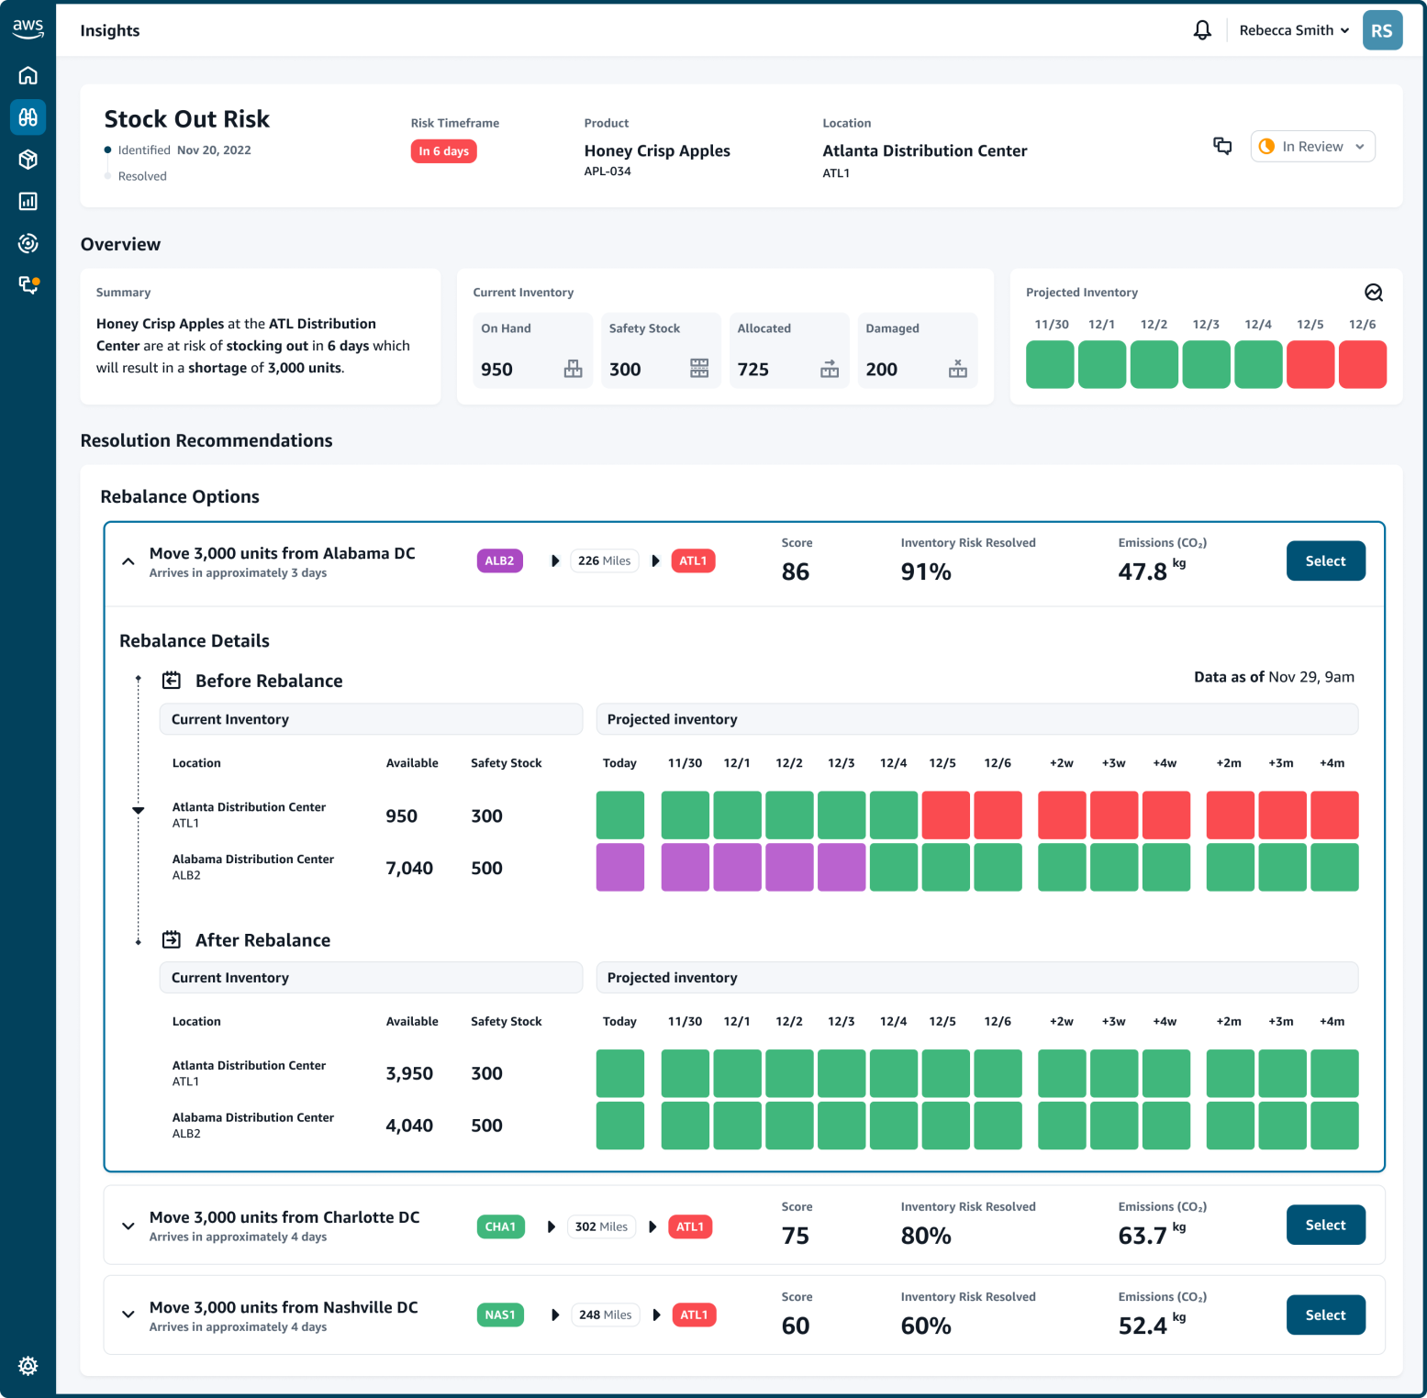

Slide 7
5. Demand planning
AWS Supply Chain Demand Planning generates more accurate demand forecasts, adjusts to market conditions, and empowers demand planners to collaborate across teams to help avoid excess inventory costs and waste.
AWS Supply Chain uses ML to analyze historical sales data and real-time data (for example, open orders), create forecasts, and continually adjust models to improve accuracy.
AWS Supply Chain Demand Planning also continually learns from changing demand patterns and
user inputs to offer near real-time forecast updates, allowing companies to proactively adjust supply chain operations.

Slide 8
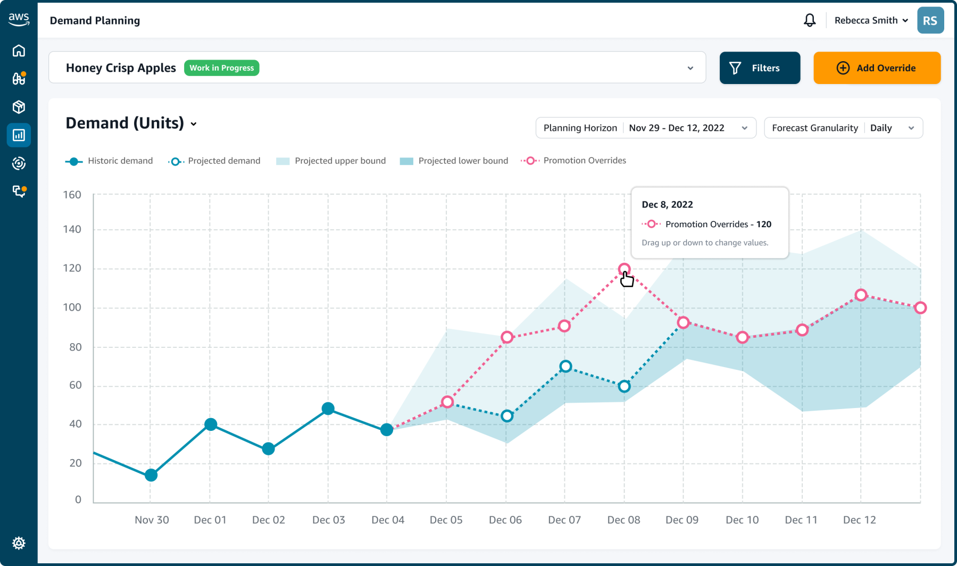

Slide 9
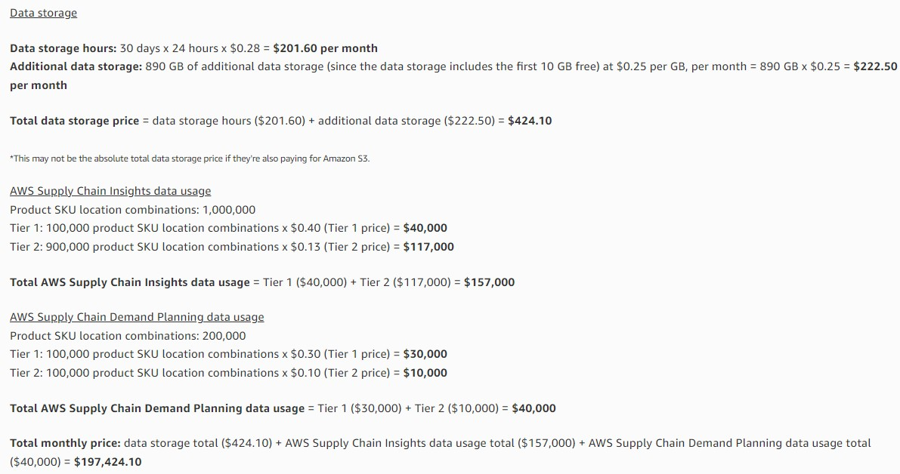
AWS Supply Chain Pricing
Supply Chain Data Lake Storage: $0.28 GB/hour
AWS Supply Chain Insights data usage: Product SKU Location Combinations: $0.40/Month
AWS Supply Chain Demand Planning data usage: Product SKU Location Combinations: $0.30/Month

Slide 10
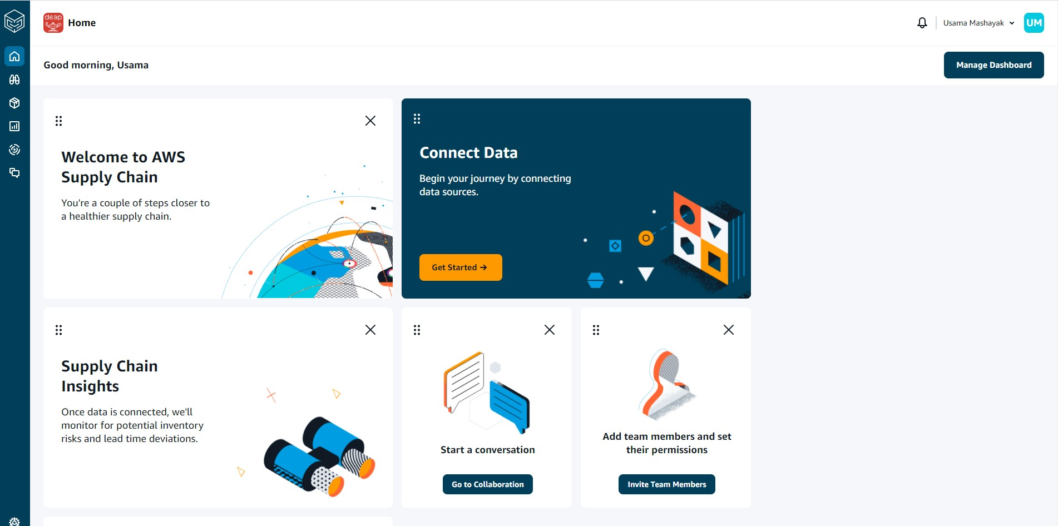

Slide 11
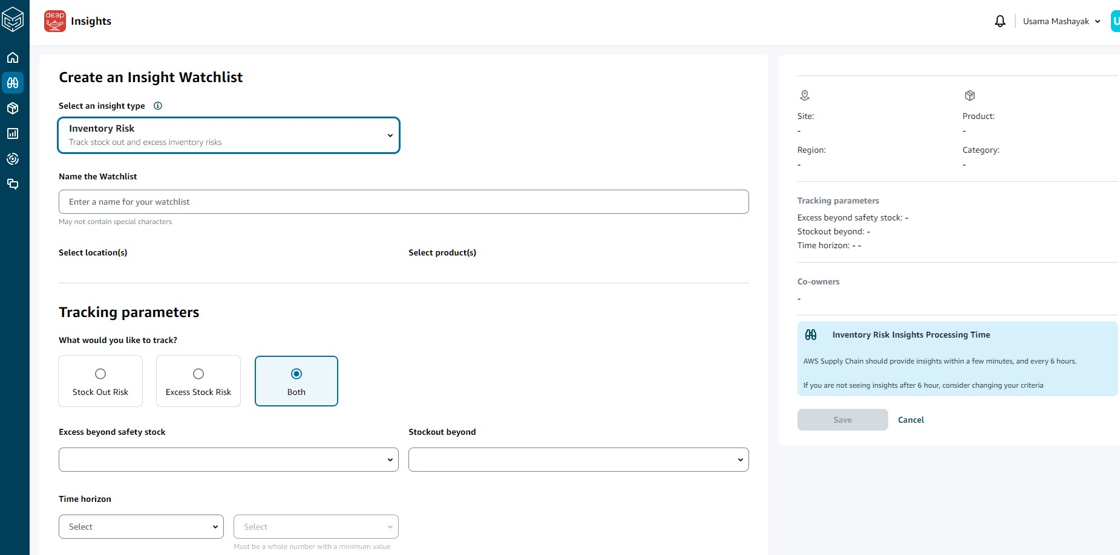
Insights Inventory Risk:

Slide 12
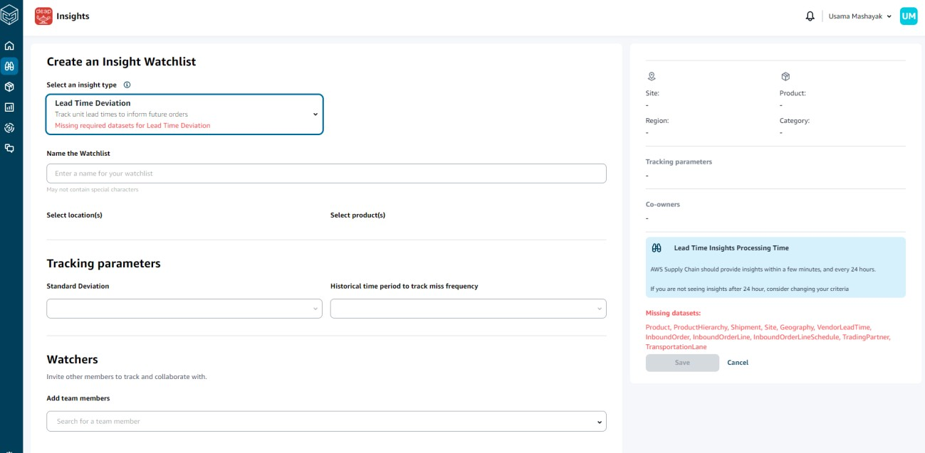
Insights Inventory Lead Time Deviation:
Missing datasets:
Product, ProductHierarchy, Shipment, Site, Geography, InboundOrderLineSchedule, TradingPartner, TransportationLane
VendorLeadTime,
InboundOrder,
InboundOrderLine,

Slide 13
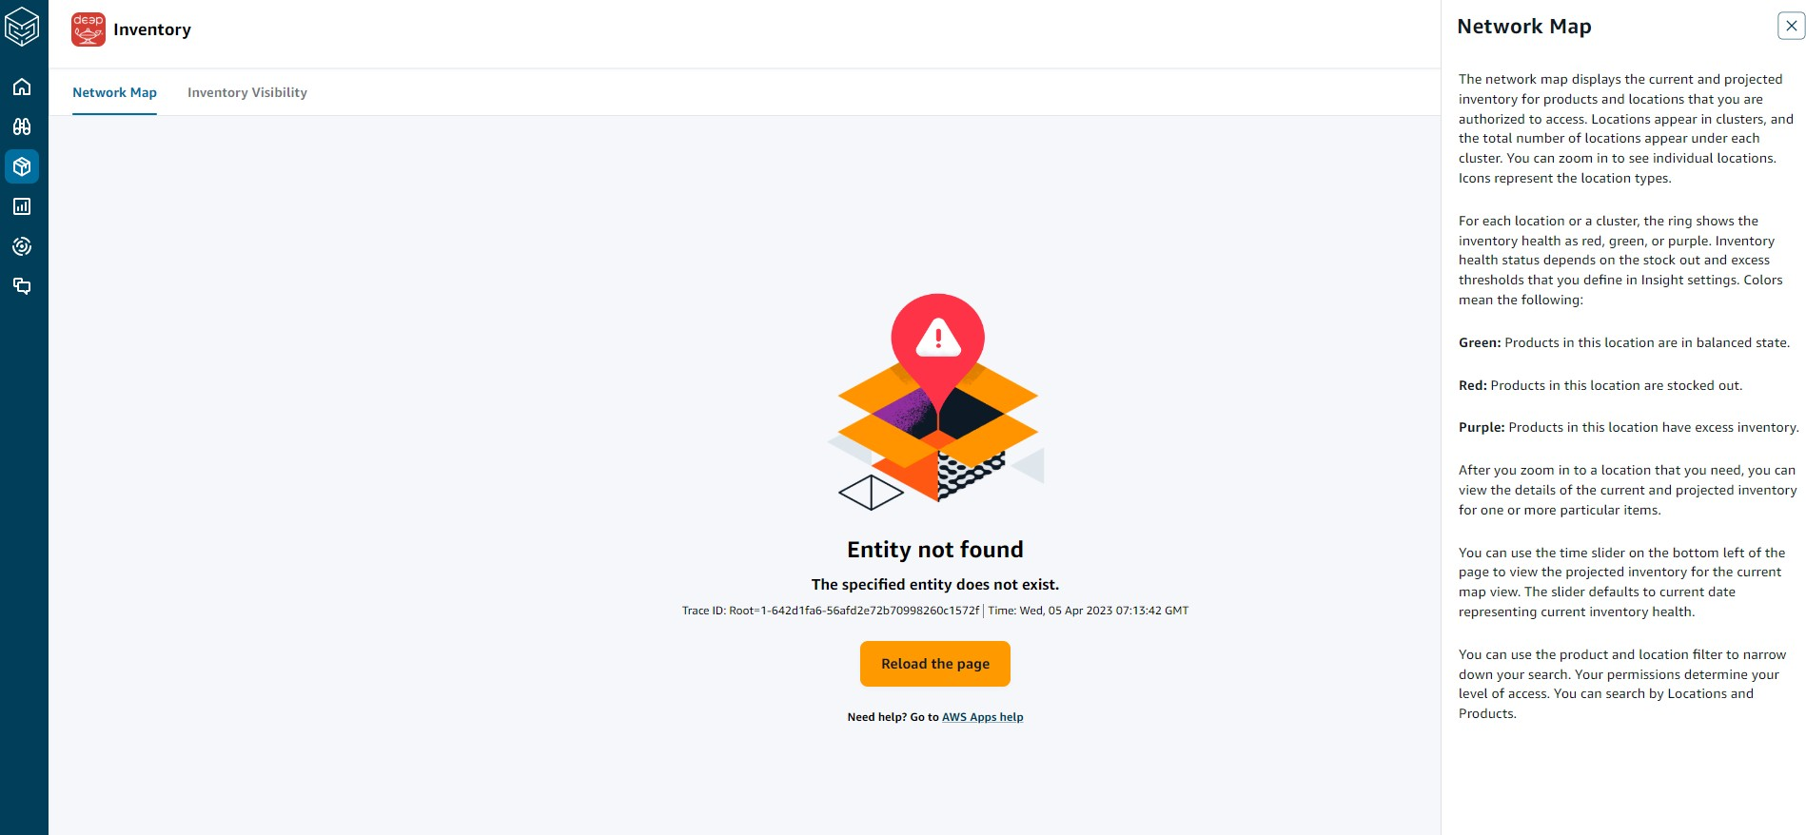
Network Map:

Slide 14
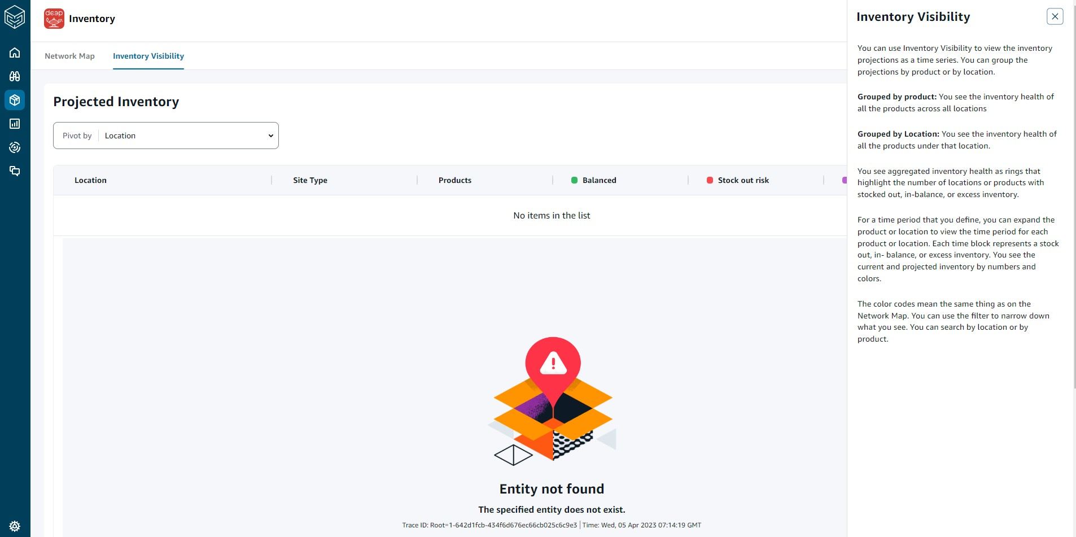
Inventory Visibility:

Slide 15
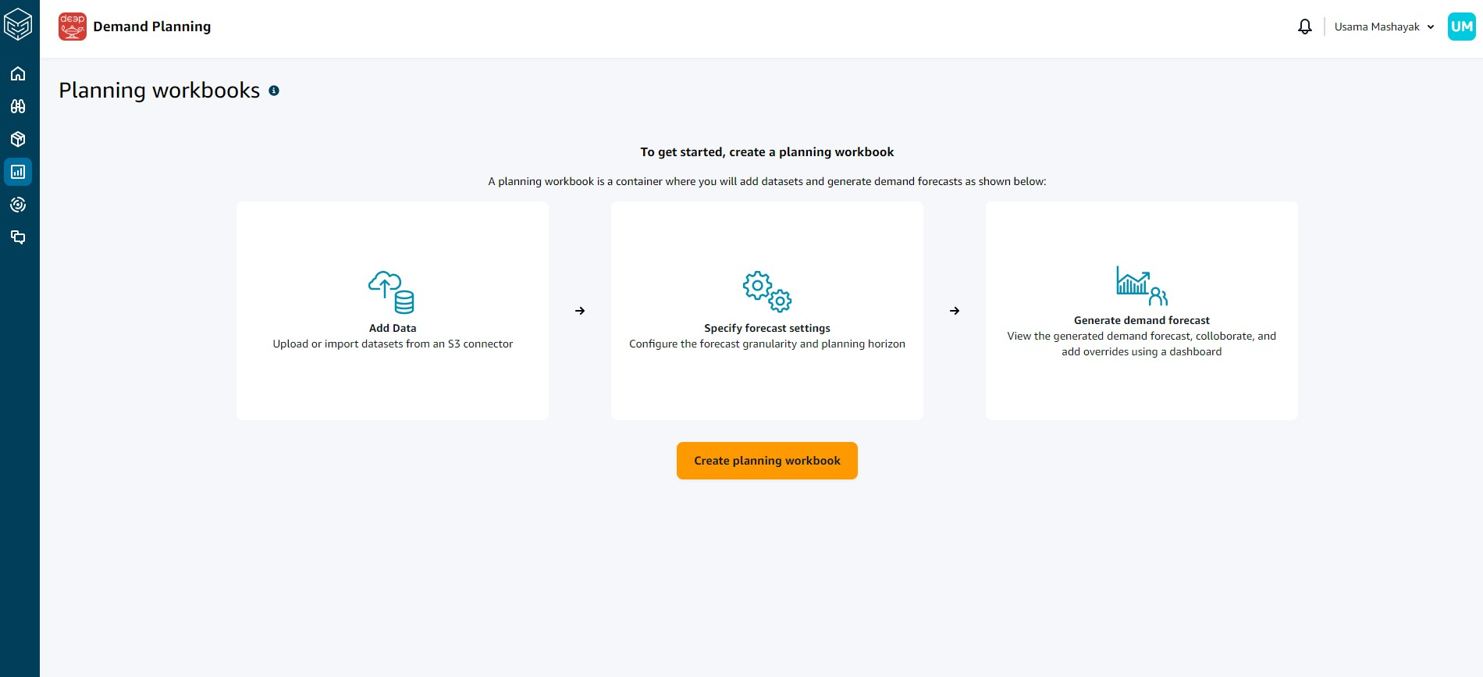
Planning workbooks:
Planning workbooks are your workspace where you can create, analyze, and collaborate on demand plans. Each workbook allows you to create planning cycles, and in each planning cycle, you can modify the forecast until you decide to publish the demand plan. Once the demand plan is published, you cannot make any changes to the workbook.

Slide 16
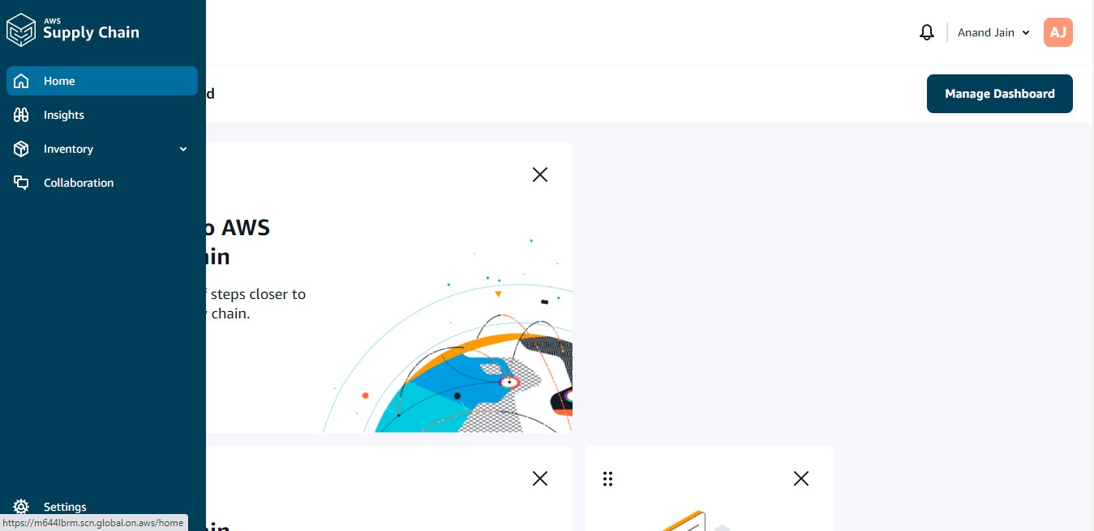
It provides different consoles based on the users profile
1. Anand Jain (Inventory Manager)

Slide 17
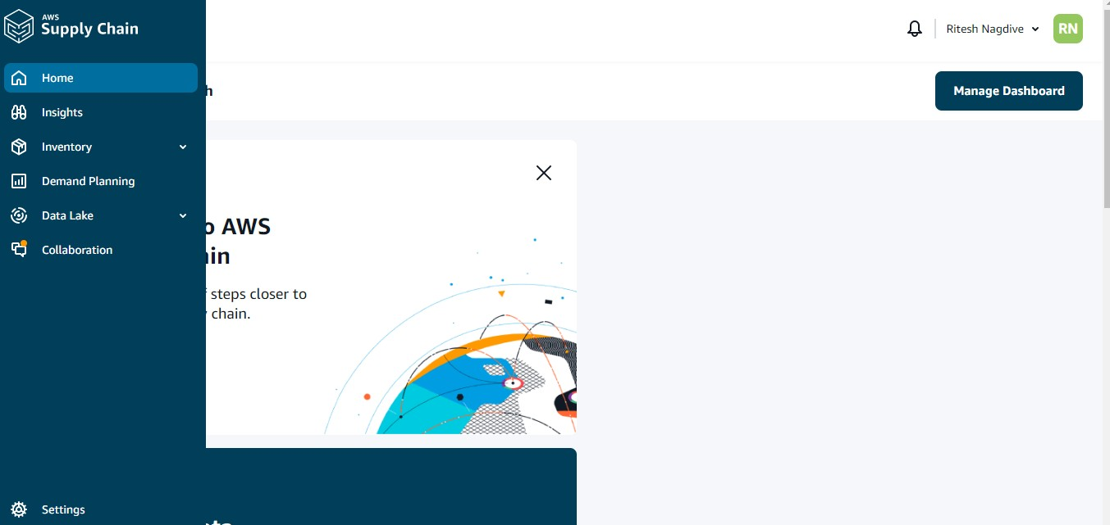
2. Ritesh Nagdive (Admin)

Slide 18
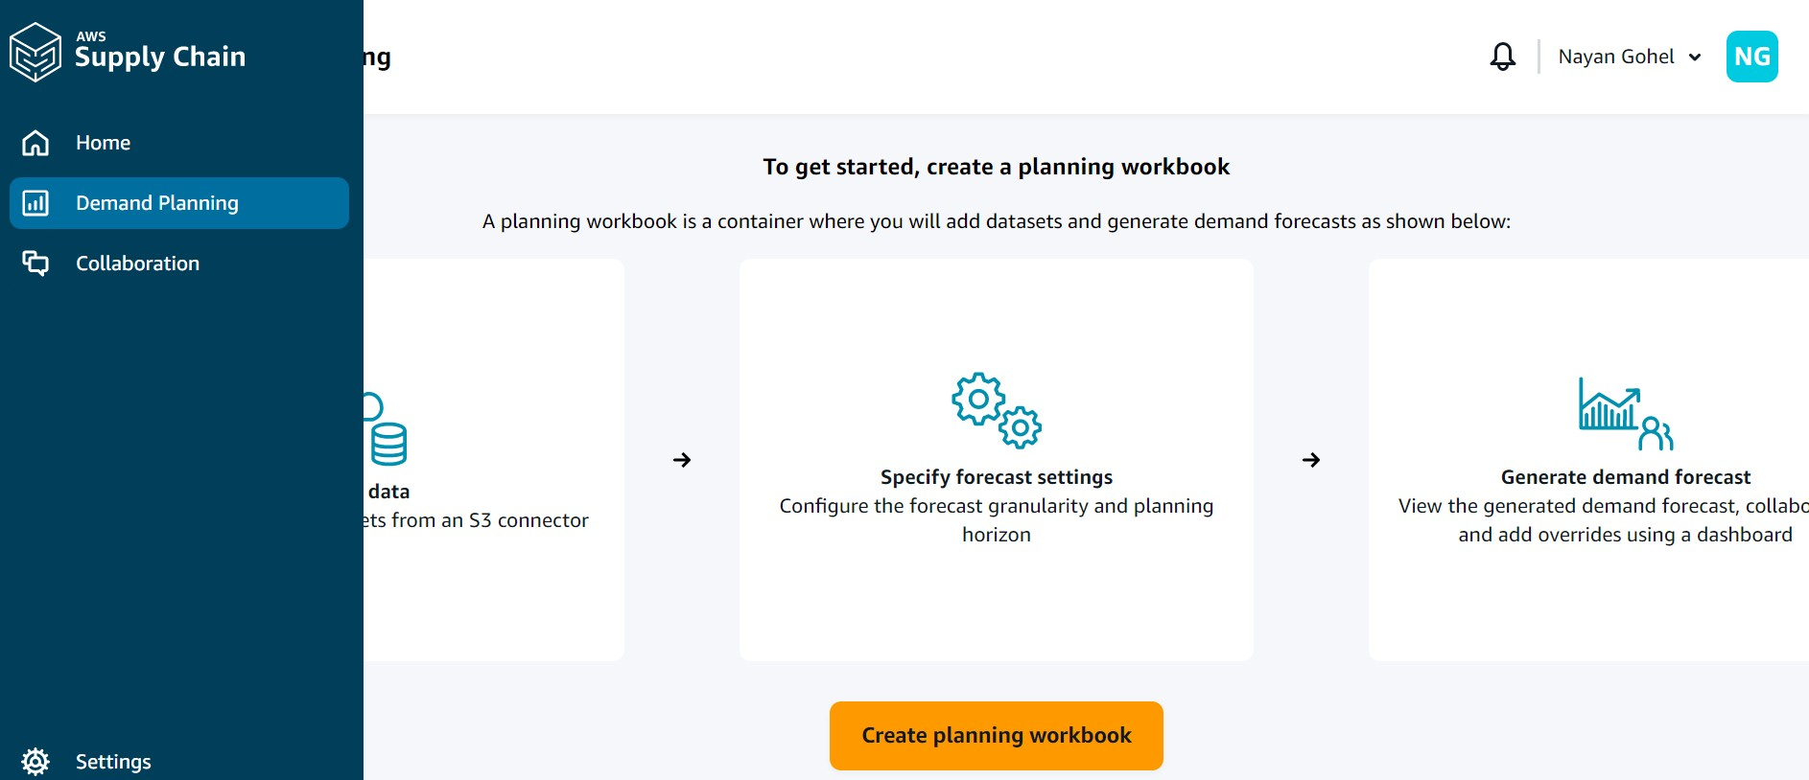
3. Nayan Gohel (Planner)

Slide 19
AWS Supply Chain administrator supports the following KPIs:
On-Time in-full | : | On-time In-Full (OTIF) measures the effectiveness of customer fulfillment operations, such as, picking, packing and shipping orders on-time and in full.
Customer order cycle time | : | Customer order cycle time measures the efficiency of the supply chain fulfillment process.
Supplier fill rate | : | The supplier fill rate measures your supplier’s commitment to your organization.
Sell-through rate | : | A sell-through rate measures the percentage of available inventory sold in a given month. This metric is calculated by adding all outbound shipment quantities for a given month divided by the sum of current inventory at the beginning of the month and the inventory received during the month.
PREREQUISITES
Note the following before uploading your data files for ingestion:
Make sure the file you upload is less than 5 GB.
Make sure the file type is supported by our connector. Our connectors for SAP systems supports CSV, our EDI connector supports .txt and .edi formats, and Amazon S3 supports CSV.
Data rows must contain non-null values for required fields.
All data must be a subset of the data fields in the entity schema. Column names must match exactly.
Data from the data source must match the data type and format defined by AWS Supply Chain.
Date and time format should follow the ISO8601 standards.
  AWS Supply Chain Demand planning

Slide 20
AWS Supply Chain Demand Planning is a web-based demand planning application that allows business users to create, collaborate, and publish demand plans.
AWS Supply Chain Demand Planning generates forecasts using proprietary machine learning algorithms based on historical forecasting experience.

Slide 21


